Slide 2
OVN: The future of Openvswitch
Dan Radez, RedHat
Vikram Dham, Futurewei Technologies Inc

Slide 3
What is OVN?
Network virtualization for Open vSwitch
Logical switches
IPv4 and IPv6 distributed logical routers
L2/L3/L4 ACLS
Tunnel Overlays
ARP/ND suppression
TOR-based L2 logical-physical gateways
Software-based L2/L3 logical-physical gateways
SFC coming very soon..
Platforms
Linux
Containers
DPDK
Integrations
OpenStack Neutron
Docker Swarm
Kubernetes

Slide 4
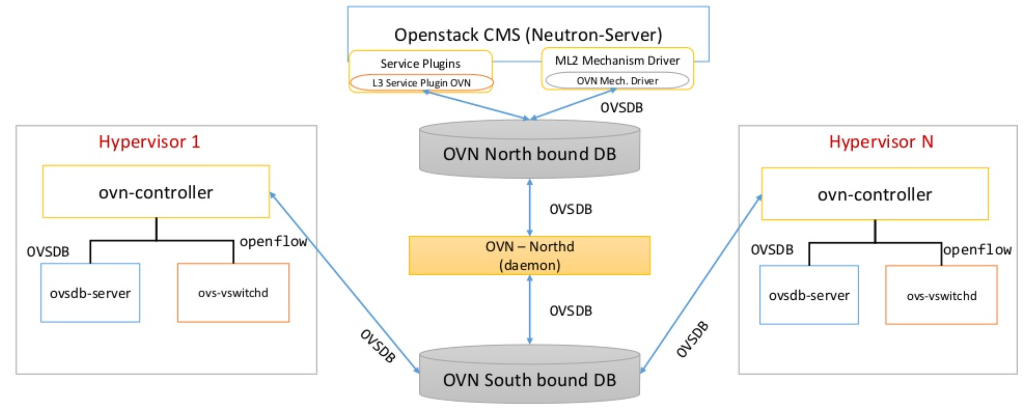

Slide 7
Why OVN?
No additional daemons to install other than what comes with OVS
Rolling upgrades
No CMS-specific L3 agent required
Simpler api for CMS developers
KISS
Think - Why do you need another SDN controller?
Notes:
OVSDB schema is versioned
Changes to schema will be managed to be backwards compatible

Slide 8
Neutron OVN integration status
https://docs.openstack.org/developer/networking-ovn/features.html
Neutron plugin support
L2 network virtualization
Security Groups - faster and fewer hops
QoS API
Native DHCP
DPDK support
Support for containers in VMs without additional overlay
OVN native L3 (Distributed) or Neutron L3 agent

Slide 9
OVN - Challenges & Opportunities
HA
Currently active/passive failover
Distributed solution is in works
SFC
upstream merge in progress - non-nsh approach

Slide 10
ovn4nfv - OVN for NFV in OPNFV E release
Enable OVN based SDN scenarios
Work with testing projects for functional testing of networking using OVN
Work with installer projects to enable OVN as a SDN option

Slide 11
Deploy OVN with Apex
OVN scenario Included with Danube & Euphrates
Virtual or baremetal deployment options
Sample configuration options included

Slide 12
About Apex
Built on RDO Triple-O
RPM based / deploys on CentOS
Contributes to upstream Communities

Slide 13
Deploying with Apex
Scenario File (os-ovn-nofeature-noha)
Inventory File
Network File
Provided for generic virtual deployment
https://wiki.opnfv.org/apex

Slide 14
Apex Virtual Deployment
CentOS 7 jump host
Apex RPMs
opnfv-deploy -v -n network_settings.yaml -d os-ovn-nofeature-noha.yaml

Slide 15
Apex Community
https://wiki.opnfv.org/apex
Freenode: #opnfv-apex
dradez@redhat.com

Slide 16
References -tbd

